Slide 1

Meal Planner
Skroutz Academy Team 3
Thodoris Theodorellis | Efthymios Pantouvakis
Vaggelis Drampalos | Vasileios Mourloukos

Slide 2
App Features
Mobile Functionality
User Login & Registration
Like / Unlike Meals
Select / Unselect Meals
Navigate Weeks to View Meal Availability
2
Skroutz Academy

Slide 3
Web Features
Website Functionality
User Login & Registration
Create & Edit Meals
Assign Meals to Specific Days
View Like & Select Counts for Each Meal
3
Skroutz Academy

Slide 4
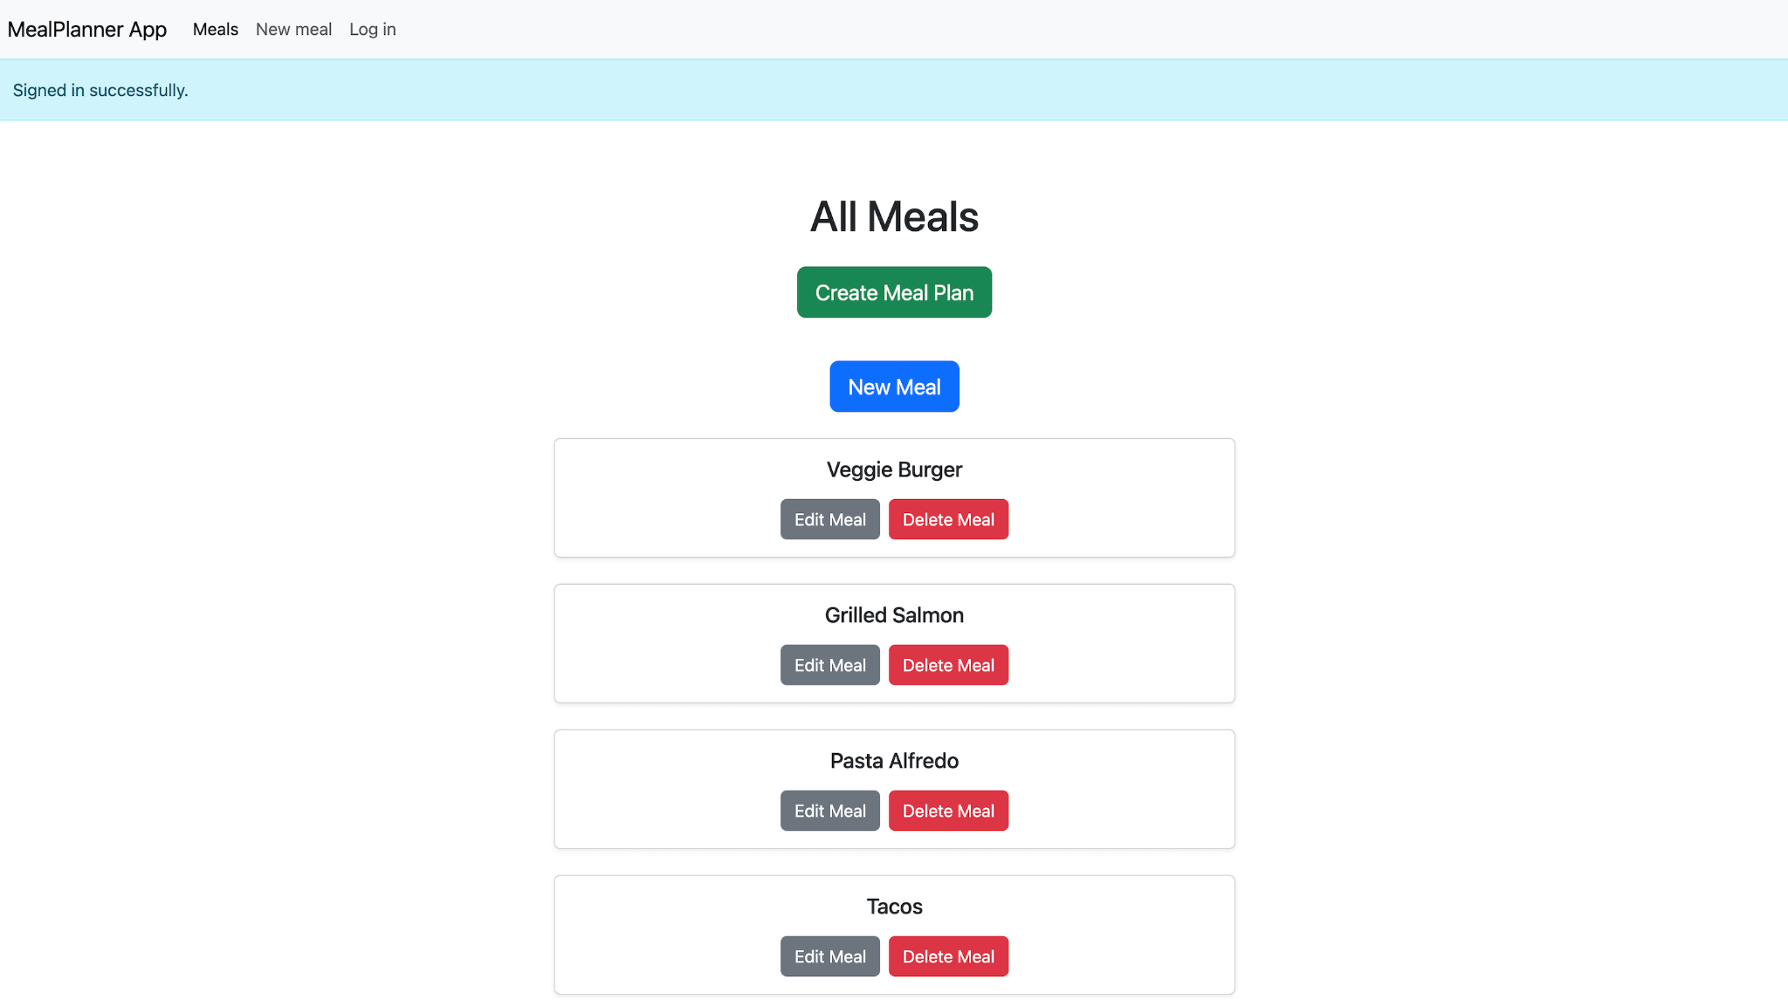
Web View
4
Skroutz Academy

Slide 5
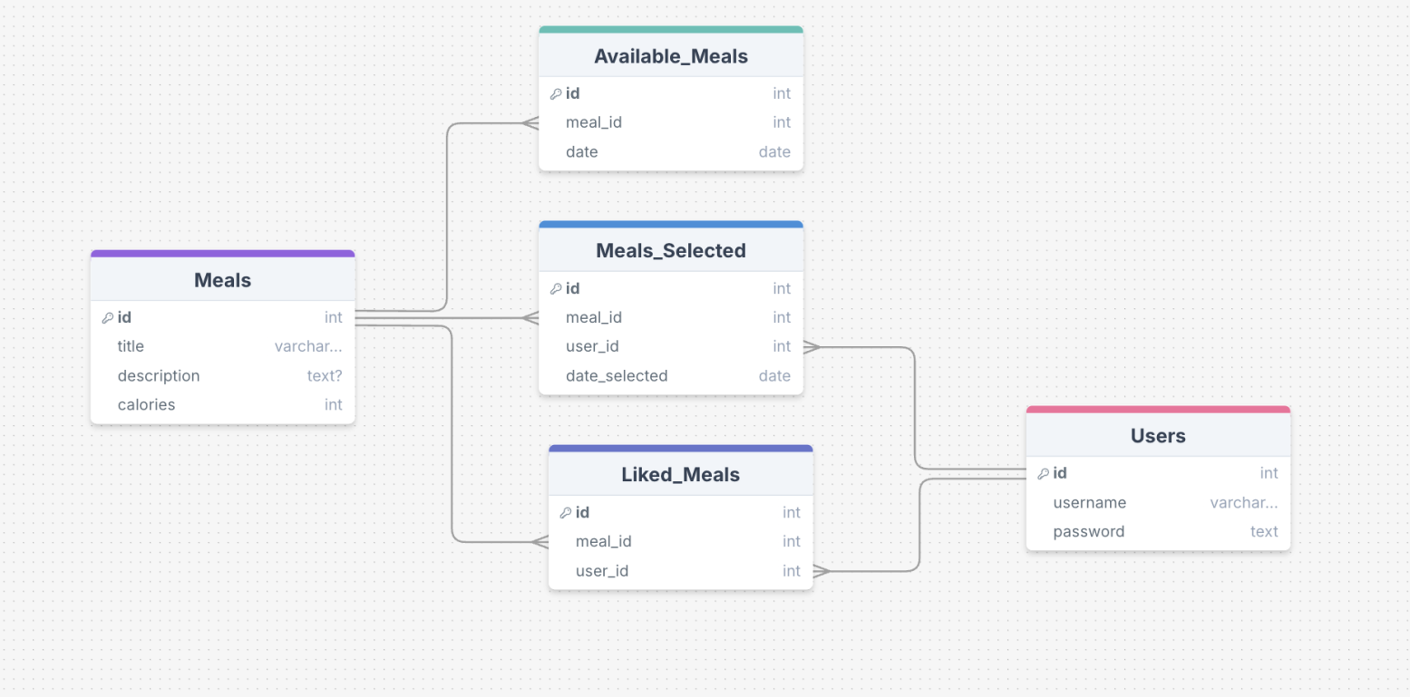
Database

Slide 6
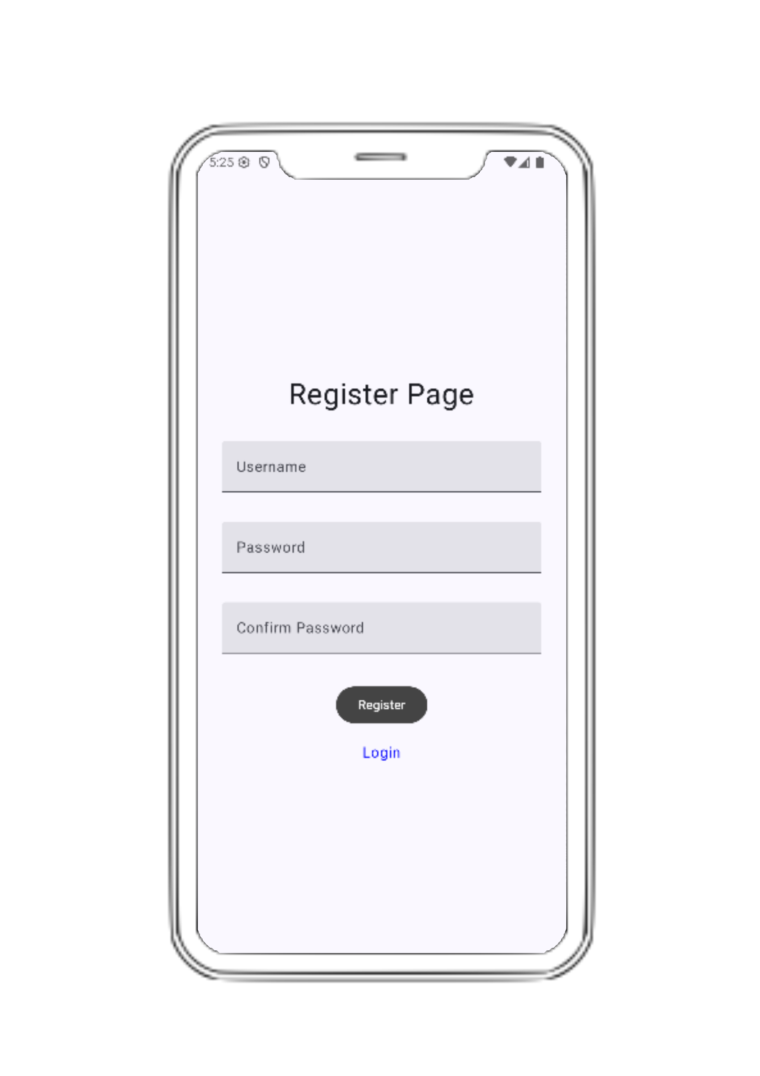
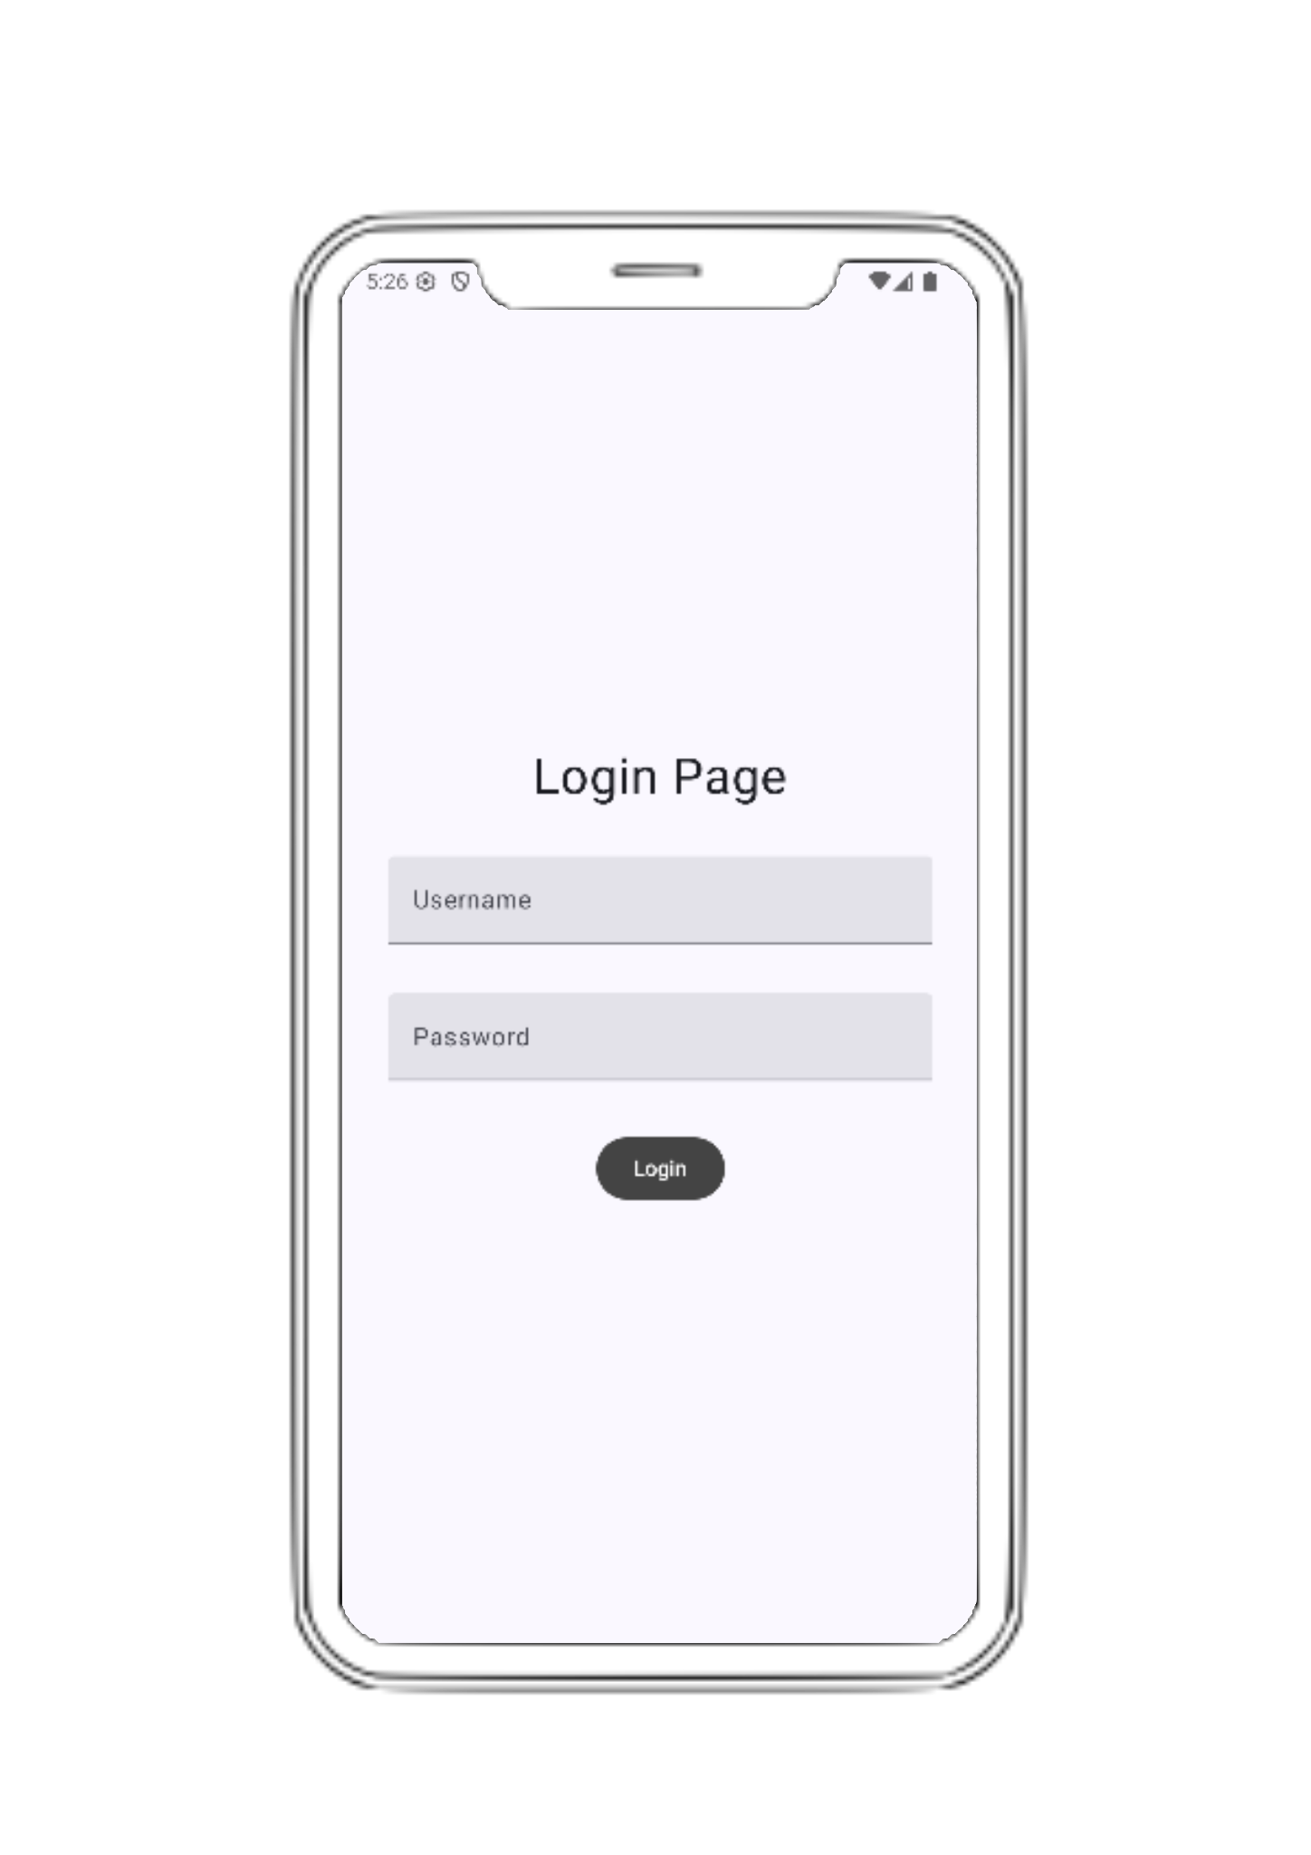
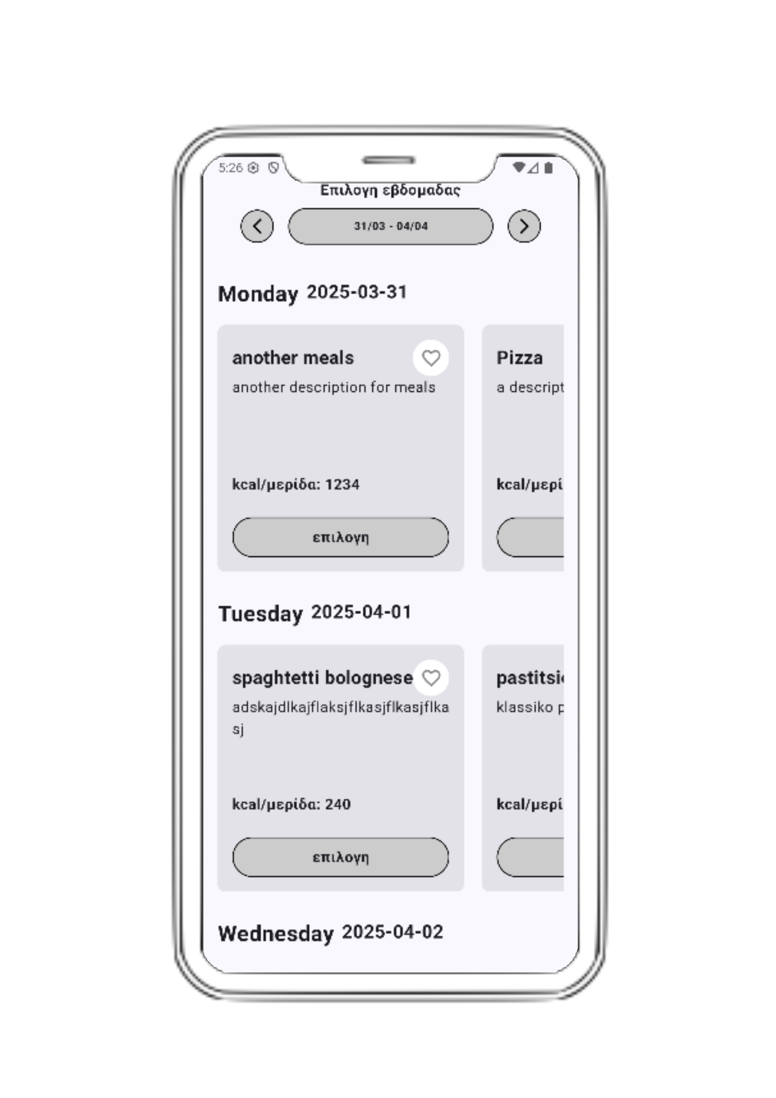
Android flow
6
Skroutz Academy

Slide 7
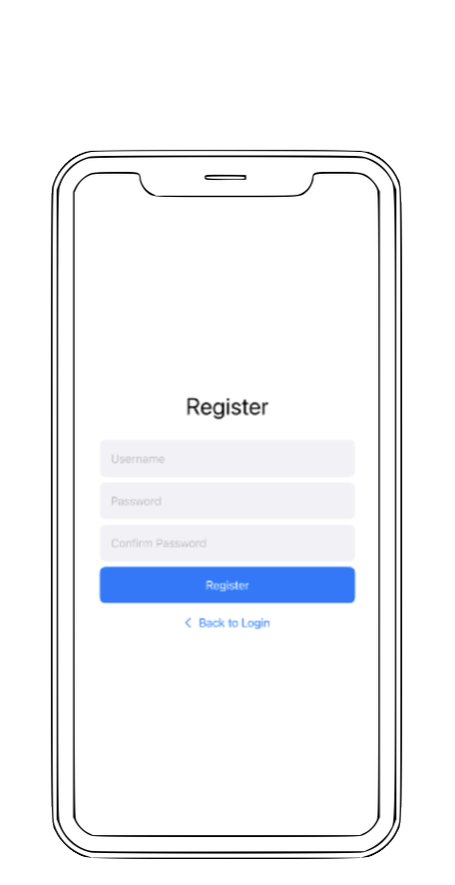
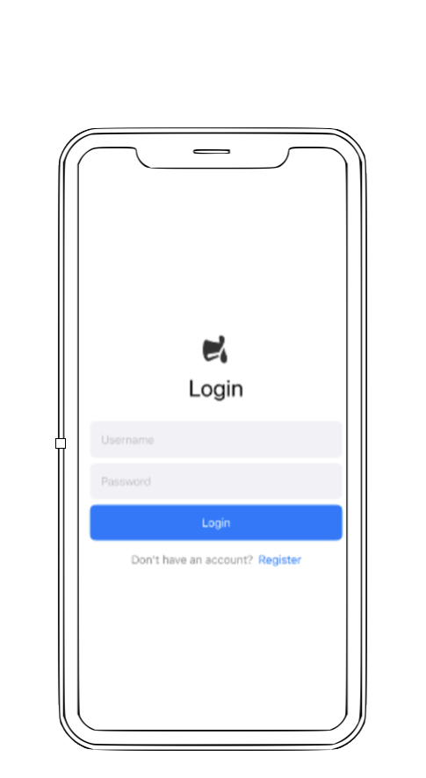
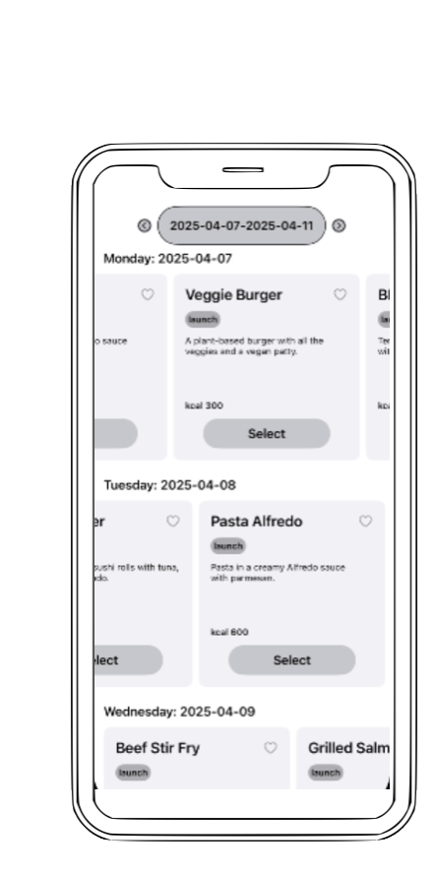
IOS flow
7
Skroutz Academy

Slide 8
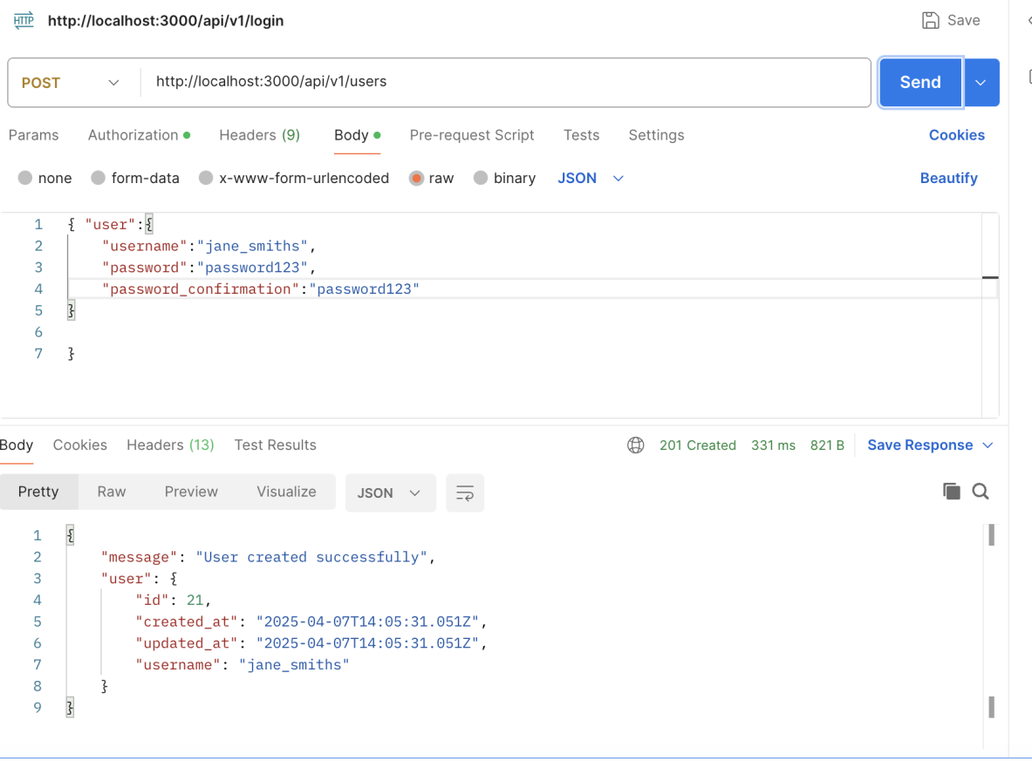

Slide 9
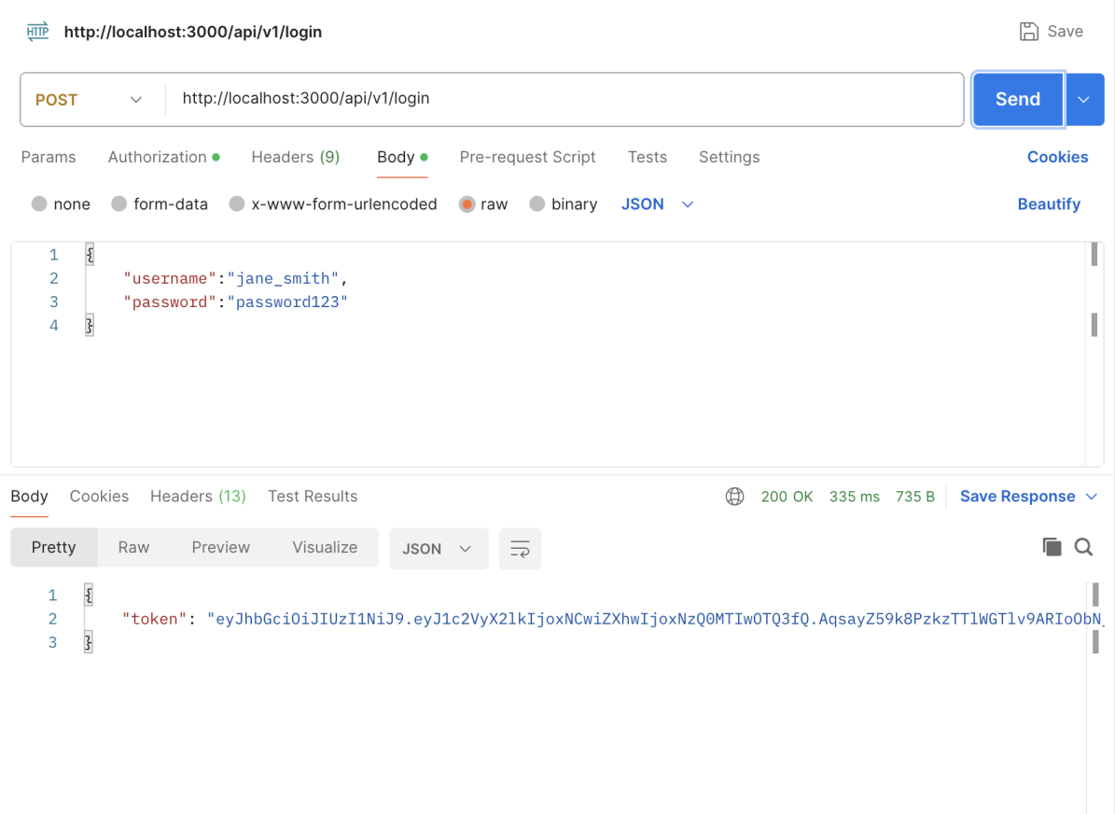

Slide 10
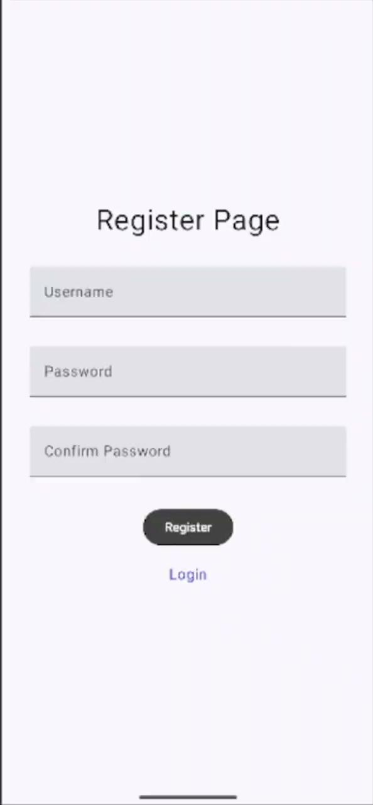
Android Demo
7
Skroutz Academy

Slide 11
QnA

Slide 12



